Slide 1
Git & GitHub

Slide 2
Explain the purpose of Git & GitHub
Initialize a git repository
Understand the Git workflow
Write clear and intentional commit messages
Push work to a remote repository

Slide 3
Version control
Git
Repository (repo)
Staging area
Commit
Push
GitHub
Local vs. Remote

Slide 4
If you could have any superpower, what would it be and why?

Slide 5



Slide 6
Git

Slide 7

What is Git?
Git is a free, open-source version control system that professional software developers use to manage their code.
Think of version control like a save system in your favorite video game:
Just like you can save your progress in a game at certain checkpoints or save points, Git saves versions of your project, letting you revert if needed.
With Git, you can try new ideas without fear, just like taking a risk in a game without losing progress.

Slide 8
Vocabulary Terms
Repository — a storage space for your project’s current state and entire history of changes over time
Staging area — a waiting room for changes before you save them
Commit — a snapshot of your project with a message explaining the updates
Pushing — sends local commits to a remote repository (GitHub) for backup

Slide 9
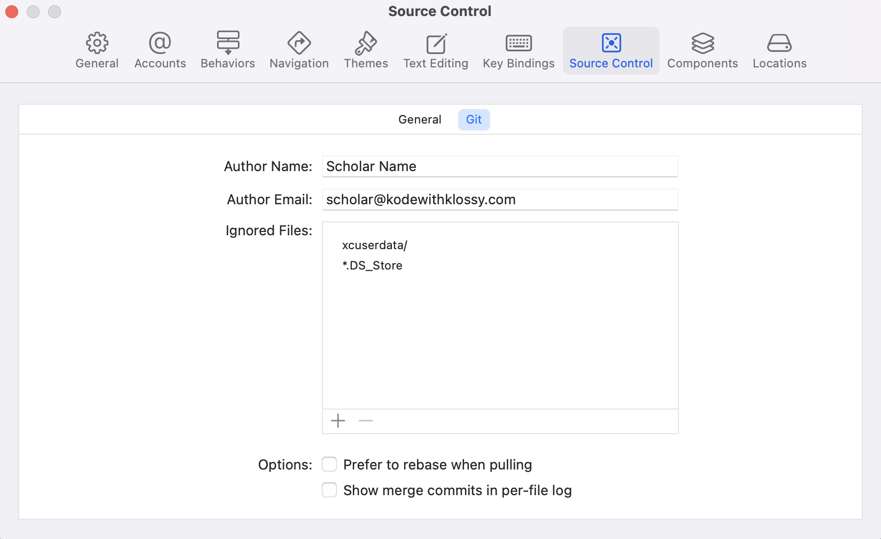
Customize Git Settings
Choose Xcode > Settings > Source Control and click the Git tab. Enter your name for the author name and a valid email address. Add two files to the Ignored Files list: xcuserdata/ and *.DS_Store.
Hint: If the Git tab doesn’t appear, select the Enable Source Control option in the General tab.

Slide 10

Initialize a Git Repository
Create a new project called GitPractice and initialize Git tracking. This step sets up version control for your project by creating a new Git repository.
In Xcode, go to Integrate > New Git Repository > Create so that your project is now tracked from the very start, with all subsequent changes recorded.
Note: If you get a message saying “All projects are already under source control” at this step, you have already initialized a Git repository when you created the project!
You’ll only do this ONE time for every new project.

Slide 11


Try-It | Git Setup
Customize your author name and email. From the Xcode menu, select Settings and then Source Control and click the Git tab.
Add ignored files: xcuserdata/ and *.DS_Store.
Create a new project called GitPractice.
Initialize Git tracking by selecting Integrate, then New Git Repository and Create.

Slide 12
Edit
Stage
Commit
1
2
Design your app and write your code
Select Integrate
and then Stage All Changes
Select Integrate and then Commit
3
The overall Git workflow is a repetitive cycle of editing, staging, and committing!

Slide 13

Describe the Git workflow in your own words! Be prepared to share with a friend.

Slide 14

Try-It | Git Workflow
Add a text view to the ContentView with the string “Change 1”.
Add your changes to the staging area with Integrate > Stage All Changes.
Commit your changes with Integrate > Commit. Add a detailed commit message (e.g. Add change 1 to ContentView) and click Commit.
Add another text view to the ContentView with the string “Change 2”.
Add your changes to the staging area with Integrate > Stage All Changes.
Commit your changes with Integrate > Commit. Add a detailed commit message and click Commit.

Slide 15
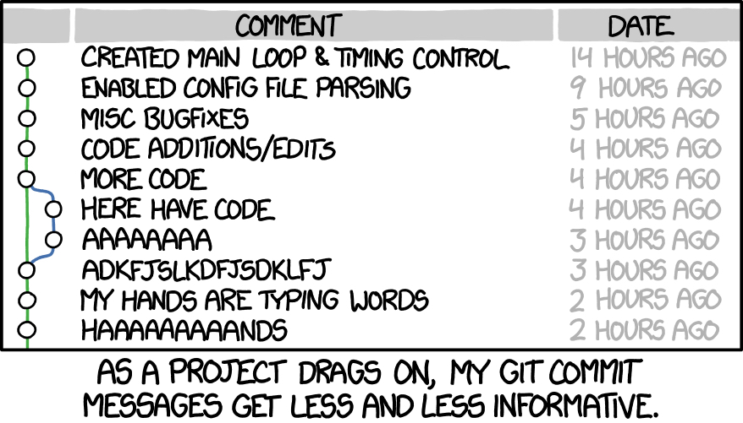

Slide 16

What issues could arise from having poorly detailed commit messages?

Slide 17

Clear Commit Messages
Clear messages help track project evolution and simplify reverting to previous states.
Clear & concise
Action-oriented
Keep it short
Remember, you’re writing these messages for your future self! Ensure you can quickly identify the commit if needed.

Slide 18
Brainstorm 3 examples of commit messages you might write while working on a project.

Slide 19
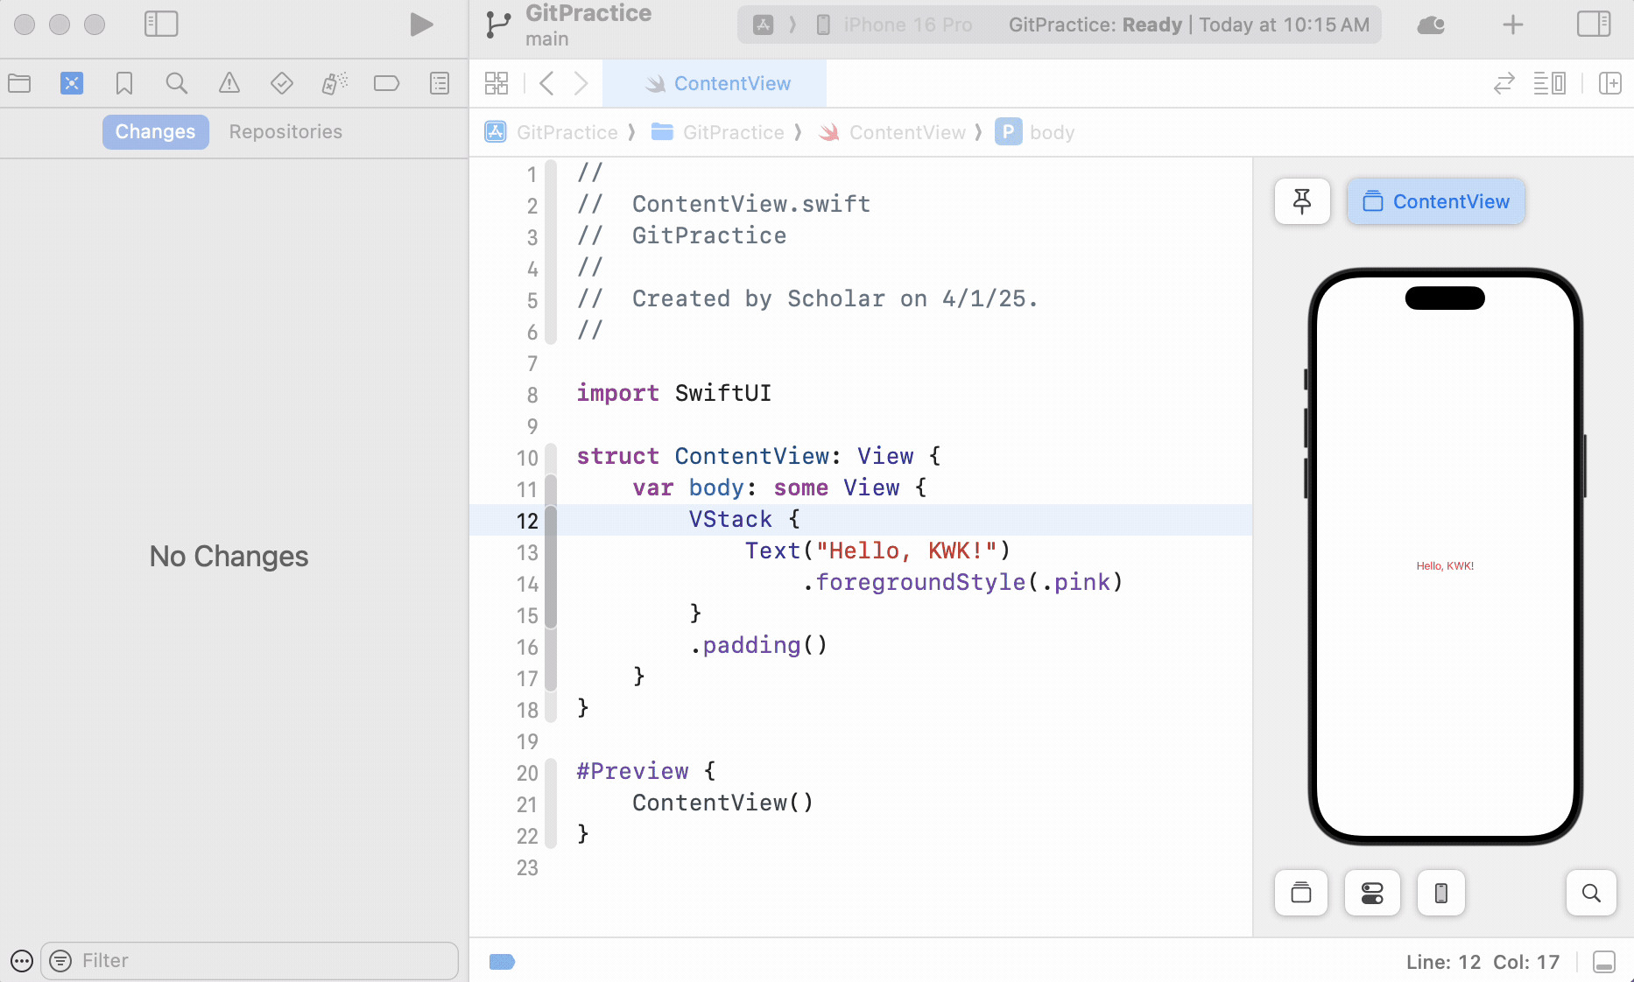
Reverting Back
In the Navigation pane, select Source Control Navigator > Repositories > Branches and select main.
Control-click on a commit and select Switch to “[commit-hash]” to restore that version of your project!
Click Switch!

Slide 20
GitHub

Slide 21

What is GitHub?
GitHub is a web-based (remote) platform for hosting and sharing Git repositories.
Think of it as your cloud backup—if your computer fails, your work is safe
Simply pull your code to any new device, just like reloading a game save
Also a platform professional developers use to showcase their work

Slide 22
What’s the difference between Git and GitHub?

Slide 23
Create a GitHub Account & Connect Xcode
You’ll only need to complete these steps one time if you’re using the same computer throughout camp!
First, you’ll create a GitHub account – make sure you choose a professional username.

Slide 24

Try-It | Connect GitHub & Xcode
Go to GitHub and create a free account if you don’t already have one.
In Xcode, select Xcode and then Settings… from the dropdown menu.
Select the Accounts tab and then the plus button (+).
Select GitHub and then Continue.
Enter your GitHub username and click the Create a Token on GitHub button. This will take you to create a personal access token on GitHub. Set the note to “Xcode”, set the expiration to 90 days, and check all of the scopes. Copy this token. Back in Xcode, paste it into the second input field and click Sign In.
Confirm that your GitHub username appears in Settings.

Slide 25
What’s a personal access token?
A personal access token is a secure way to connect Xcode to GitHub without using your password.
It grants specific permissions, has an expiration date, and can be easily revoked for better security.

Slide 26
Create a Remote Repo on GitHub
You only need to do this one time for each project you want to save on GitHub!
You already have a GitPractice project and you initialized a local Git repository. Now you need to create a remote repository on GitHub where you can store your project on the web!

Slide 27
Try-It | Create a Remote GitHub Repo
In your GitPractice project in Xcode, select Source Control Navigation in the Navigation Pane and then Repositories.
Control-click Remotes and then the New ‘your-project-name’ Remote… option.
Don’t change anything and click Create.
Go back to GitHub and select Repositories. You should see your GitPractice project!
Click the title of your project to view the code. This URL is the one you can use to share your project with others!

Slide 28
Pushing to Your GitHub Repo
Git will not automatically sync your local changes with GitHub—you’ll need to do this manually by pushing your work!
As you continue working on your project, stage your changes and commit your work as usual. After you have one or more commits, you can push those commits to GitHub!

Slide 29

Try-It | Push New Changes to GitHub
Add a text view to the ContentView with the string “Change 3”.
Add your changes to the staging area with Integrate > Stage All Changes.
Commit your changes with Integrate > Commit. Add a detailed commit message (e.g. Add change 3 to ContentView) and click Commit.
Push your work to GitHub with Integrate > Push.
Check out your work on GitHub!

Slide 30
Next Up
For each project you create during camp, practice using these steps to save your work along the way and then push your work to the remote repository on GitHub!
By saving your work to GitHub, you’ll be able to access all of your projects after camp.

